Slide 1

Classification of Movies According to Weather
Kanak Kaushik
Student no. x18136966

Slide 2
Content
Motivation
Research Title
Literature Review
Methodology
Results
Discussion
Conclusion and Future Work

Slide 3
Motivation
Watching the right movie can stimulates all kinds of emotions.
Lot of intrinsic and extrinsic factors affects one's choice of movie.
According to Biancalana, Gasaretti, et.al, there’s not enough research in the context aware recommendation of movies to user.
Notes:
https://exploringyourmind.com/film-therapy-benefits-watching-movies/
https://www.researchgate.net/publication/254003790_Context-aware_movie_recommendation_based_on_signal_processing_and_machine_learning
There was a study done by exploring your mind , ….. They have coined the term film therapy which helps pychotherpasit to coach and develop a therapy based on tv series and movies applying their benefits to the subjects.
It helps people to overcome their fears and focus on their problems
Helps with relaxation
Motivation like pursuit of happiness
Build personal relationships with society and many more.
Hence I chose this topic to study.
Netflix, streaming services like Disney+ hbo

Slide 4
Research Title
Auto-Recommendation of Movies from Weather Prediction using Machine Learning: Dublin, Ireland

Slide 5
Literature Review
Predictions using weather data
Energy
Travel
Accident
Energy Loads in regions of Italy | ARIMA and NWP
Energy performance of Building | Statistical and Downscaling methods
Tour Time in New York City | Regression
Travel time in California | Robust Regression
Risks of accident in Finland | Palm opportunity
Time and weather during accident | Regression
Notes:
ARIMA explain numerical weather predictions has been used to determine the loads of certain areas
Downsized records into seasonal components
Palm opportunity which means that that the occasion takes place indefinitely,
Regression A regression model is used to investigate the relationship between two or more variables and estimate one variable based on the others.
Robust regression is an alternative to least squares regression when data is contaminated with outliers or influential observations and it can also be used for the purpose of detecting influential observations

Slide 6
Movie Recommendation
Group level sentiment analysis | Kbridge recommendation system
Movie ratings | Similarity matrix
Tags and ratings of movie
Social movie network
Notes:
Kbridge consists of multiple data mining techniques (Infact,the system mines thecorrelations and interactions between different groups of people, which are correlated with specific TV episodes or movies, in social networks. Based on the correlation studied from the social network domain, system will provide program suggestions in online program streaming sites according to the flow )
Similarity matrix consist of the feature of movie and rating matrix of those movies
SMN Social network analysis is an effective means to extract semantic information from movies
Every user checks the movie ratings and tags before watching the movie on social media for critiques on the movie and then decide whether to go watch or not.

Slide 7
Methodology
Weather Database
ARIMA Algorithm
Forecasting Model
Data Extraction & Cleaning
Movie Database
Case Based Reasoning (KNN)
Movies

Slide 8


Datasets
Weather data: downloaded from Met Eireann website.
Movie data downloaded from MovieLens.org.
Both the datasets are divided in 80% and 20% proportion for training and testing.
Notes:
Explain the datasets,
Preprocessing
All the columns explain

Slide 9
Methodology (Weather prediction)
A comparative model is designed (ARIMA and ES) to choose best fit model.
ARIMA and ES are considered to be the most preferred algorithms for seasonal time series forecasting.
auto.arima() and ets() function of forecast and tseries packages of R are used to implement these two models.
Further logic is used to add respective weather labels.

Slide 10
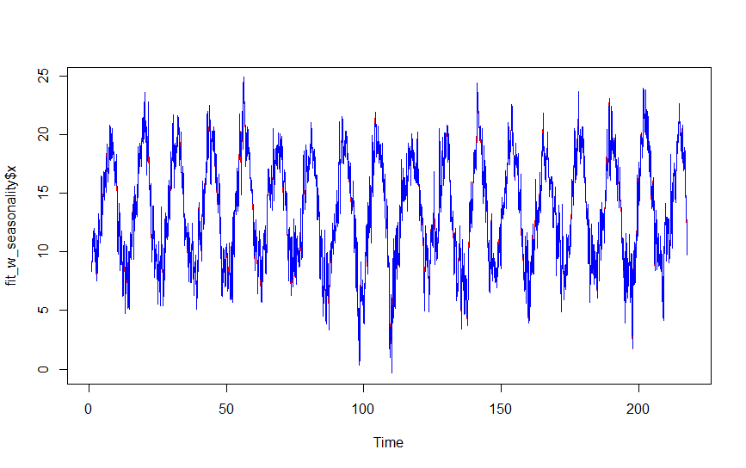
Result Weather
The RMSE for predicting temperature using ES model is 2.10 while, that using ARIMA is 0.65.
ARIMA is chosen for forecasting weather.
The RMSE of the three forecast are:
Temp: ARIMA (3,0,2) (2,0,1) [30] | 0.39421
Sun: ARIMA (2,0,2) | 0.650
Rain: ARIMA (2,0,3) | 0.298

Slide 11
Methodology (Movie)
According to research, humans tends to respond different emotions while watching different movies.
Hence, classification algorithms in weather context is implemented for movie model.
It uses K- nearest neighbour and Random Forest algorithms as the classification algorithm.
knn() and randomForest() function of caret package in R is used to implement this model.

Slide 12
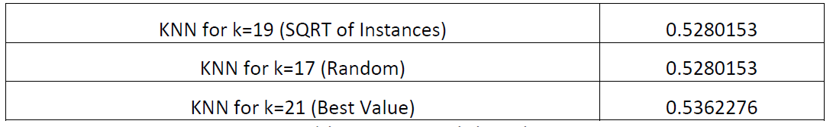
Result Music
Different values of K is considered to get the model of highest accuracy.
The model with k=21 is the best fit model.
Notes:
mtry variable is chosen from the set of predictors, to form each split a different random set of variables.

Slide 13
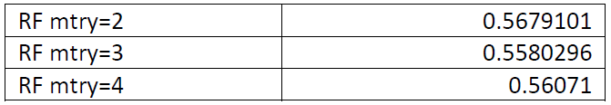
Different values of mtry is chosen for random forest, best is mtry = 2
Random forest is chosen for the classification as it has the highest accuracy of approx. 0.57 rather than 0.53 accuracy of KNN.

Slide 14
Discussion
The classification model of movie classification has (accuracy = 57%).
This study shows a better forecast accuracy of RMSE of 0.298.

Slide 15
Conclusion and Future Work
The model efficiently classifies the movies in the context of weather with an accuracy of 0.57.
Future Work:
The study can be experimented online to explore user’s feedback.
Multiple factors influencing movie preferences can be studied all together.
Same study can be applied to correlated areas like food delivery business or productivity at workplace.

Slide 16
Thank you

